Slide 1

Basic Electrical Engineering (BEEE101L)
Presented By
Dr. Maddela Chinna Obaiah
Assistant Professor (Sr)
School of Electrical Engineering

Slide 2
Module – 2: AC circuits
Alternating voltages and currents, AC values,
Single Phase RL, RC, RLC Series circuits,
Power in AC circuits –Power Factor
Three Phase Systems – Star and Delta Connection

Slide 3
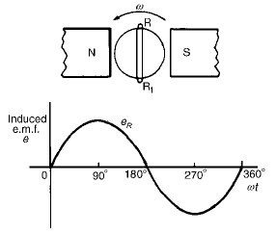
Recap: Single-Phase Systems
The voltage induced by a single coil when rotated in a uniform magnetic field is shown in Figure and is known as a single-phase voltage.
It has two wires, one called the live conductor (usually colored Red) and the other is called neutral conductor (usually colored Black).
Represented by:
Waveform
Equation
Phasor
The standard voltage for a single-phase a.c. supply is 240 V.

Slide 4
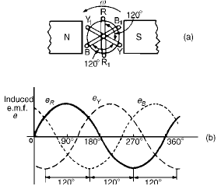
Three-Phase Systems
A three-phase supply is generated when three coils are placed 120° apart and the whole rotated in a uniform magnetic field as shown in Figure.
The result is three independent supplies of equal voltages which are each displaced by 120° from each other as shown in Figure.
The convention adopted to identify each of the phase voltages is: R-red, Y-yellow, and B-blue.
The phase sequence is the time order in which the voltages pass through their respective maximum values.
A three-phase a.c. supply is carried by three conductors, called ‘lines’. The currents in these conductors are known as line currents (I_{L}) and the p.d.’s between them are known as line voltages (V_{L}).
A fourth conductor, called the neutral is often used with a three-phase supply.

Slide 5
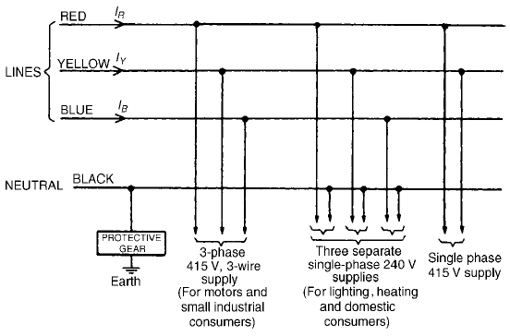
Advantages of three-phase systems over single phase
All electric power is generated and distributed in three-phase at the operating frequency of 50 Hz (or ω = 314 rad/s). When one-phase or two-phase inputs are required, they are taken from the three-phase system rather than generated independently.

Slide 6
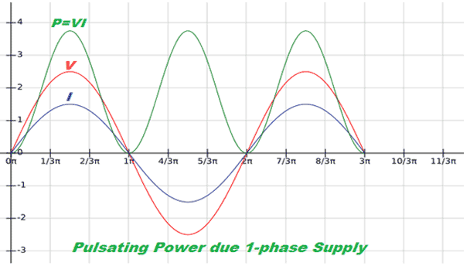
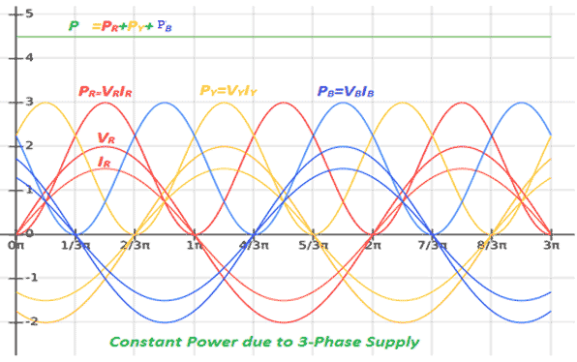
The instantaneous power in a three-phase system can be constant (not pulsating). This results in uniform power transmission and less vibration of three-phase machines.

Slide 7
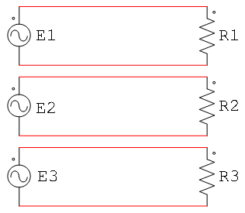
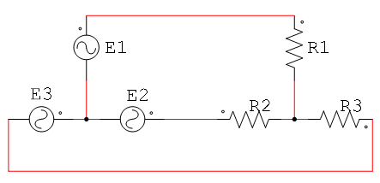
For the same amount of power, the three-phase system is more economical than the single-phase. The amount of wire required for a three-phase system is less than that required for an equivalent single-phase system.
A single three-phase system
Three single-phases systems.

Slide 8
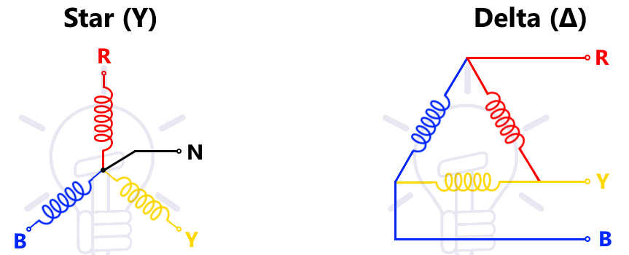
Star and Delta connections
If the three-phase windings are kept independent then six wires are needed to connect a supply source (such as a generator) to a load (such as motor).
To reduce the number of wires it is usual to interconnect the three phases. There are two ways in which this can be done, these being:
Star or Wye Connection
Delta or Mesh Connection

Slide 9
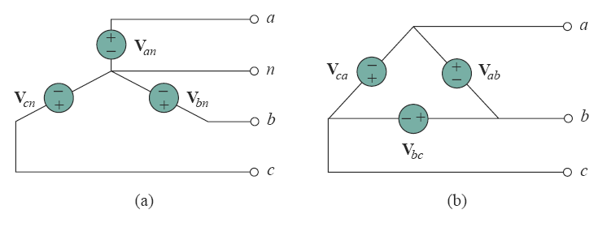
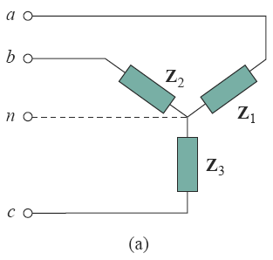
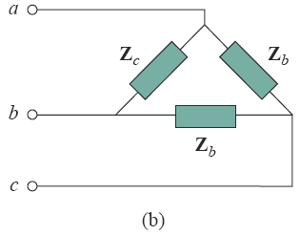
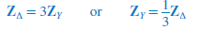
Three phase source
Three phase load
For a balanced wye-connected load,
For a balanced delta- connected load,

Slide 13
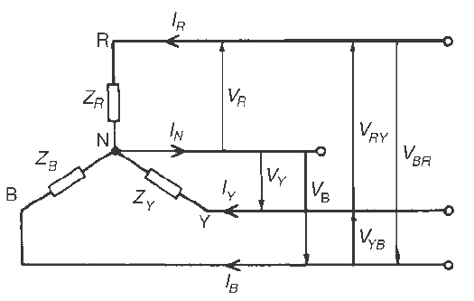
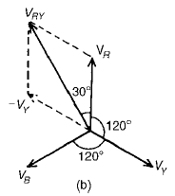
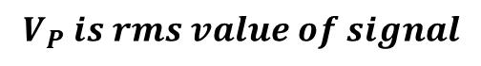
Star connection
$$V_{P} is rms value of signal$$
The three line conductors are connected to a load and the outlets from the loads are joined together at N to form the neutral point or the star point.
The voltages, V_{R}, V_{Y} and V_{B} are called phase voltages or line to neutral voltages. Phase voltages are generally denoted by V_{p}.
The voltages, V_{RY}, V_{YB} and V_{BR} are called line voltages.

Slide 14
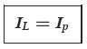
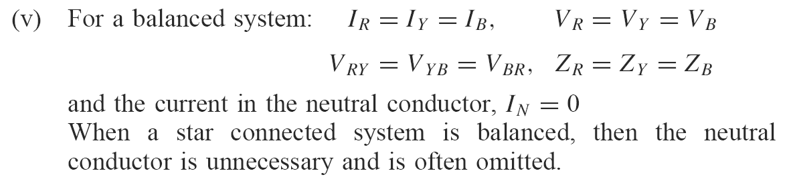
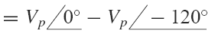
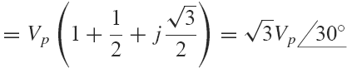
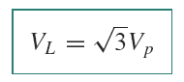
(iv) The phase currents (generally denoted by I_{p}) are equal to their respective line currents I_{R}, I_{Y} and I_{B}, i.e. for a star connection:
(vi) The line voltage, V_{RY},
V_{RY} = V_{R} − V_{Y} (V_{Y} is negative since it is in the opposite direction to V_{RY}).

Slide 15
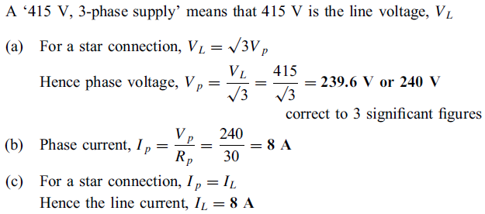
Problem: Three loads, each of resistance 30 , are connected in star to a 415 V, 3-phase supply. Determine (a) the system phase voltage, (b) the phase current and (c) the line current.
Solution:

Slide 16
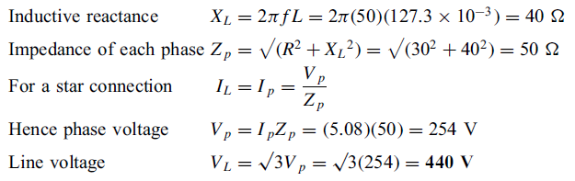
Problem: A star-connected load consists of three identical coils each of resistance 30 and inductance 127.3 mH. If the line current is 5.08 A, calculate the line voltage if the supply frequency is 50 Hz
Solution:

Slide 17
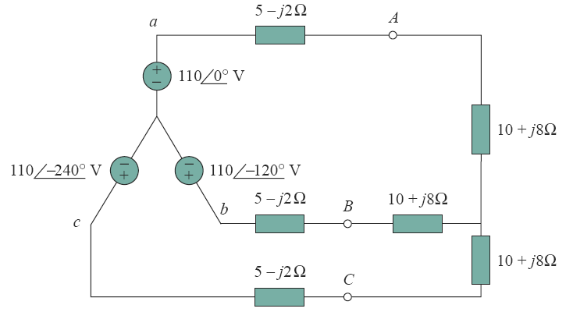
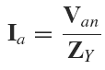
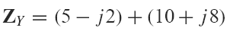
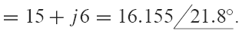
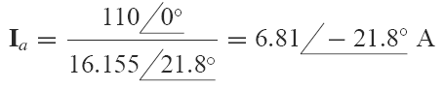
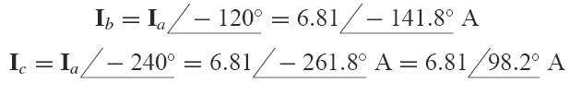
Problem: Calculate the line currents in the three-wire Y-Y system of Fig.
Solution:
where

Slide 18
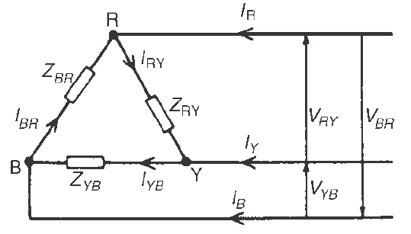
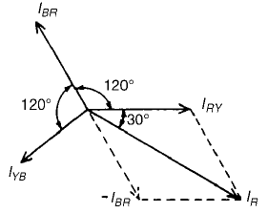
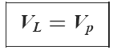
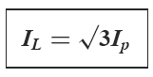
Delta connection
It can be seen that the line voltages V_{RY},V_{YB} and V_{BR} are the respective phase voltages, i.e. for a delta connection:
I_{R} = I_{RY} - I_{BR} = I_{RY} + (- I_{BR})

Slide 19
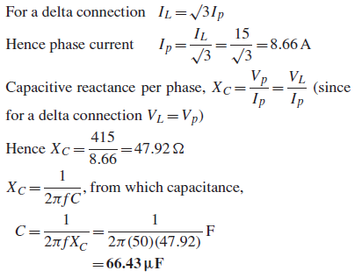
Problem: Three identical capacitors are connected in delta to a 415V, 50Hz, 3-phase supply. If the line current is 15 A, determine the capacitance of each of the capacitors.
Solution:

